Slide 1
An Automated Trading System using Recurrent Reinforcement Learning
Abhishek Kumar[2010MT50582] Nimit Bindal[2010MT50606]
Lovejeet Singh[2010CS50285] Raghav Goyal [2010MT50612]

Slide 2
Introduction
Trading technique
An asset trader is implemented using recurrent reinforcement learning (RRL) as suggested by Moody and Saffell (2001)
It is a gradient ascent algorithm which attempts to maximize a utility function known as Sharpe’s ratio.
We denote a parameter vector which completely defines the actions of the trader.
By choosing an optimal parameter for the trader, we attempt to take advantage of asset price changes.

Slide 3

Notations
The price series is
- The corresponding price changes (returns)
$F_{t}$ - Position taken in each time step
$R_{t}$ - System return in each time step

Slide 4









The System
1
$w_{t}$ - Parameters vector (which we attempt to learn)
$r_{t}$ - Price changes till time t (returns)
$F_{t−1}$ - Previous position taken
Our system is a single layer recurrent neural network
$$r_{1}$$
v
$$w_{1}$$
$$w_{2}$$
tanh()
$$F_{t}$$
$$r_{2}$$
$$w_{M}$$
$$F_{t−1}$$
$$r_{M}$$
delay

Slide 5
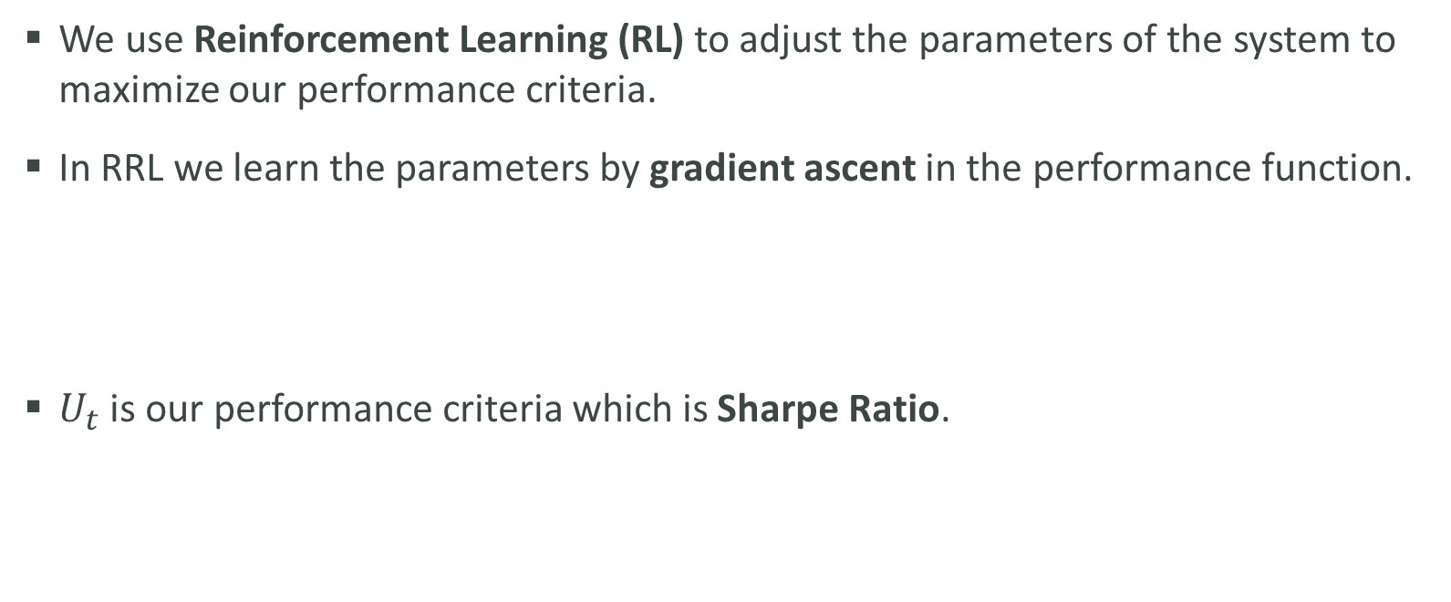
The Learning Algorithm
We use Reinforcement Learning (RL) to adjust the parameters of the system to maximize our performance criteria.
In RRL we learn the parameters by gradient ascent in the performance function.
$U_{t}$ is our performance criteria which is Sharpe Ratio.

Slide 6
Project Goals
Implement an automated trading system which learn its trading strategy by Recurrent Reinforcement Learning algorithm.
Analyze the system’s results & structure.
Suggest and examine improvement methods.

Slide 7
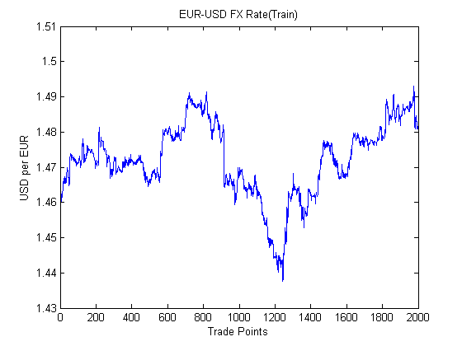
Sample Training Data
The sample price series are of US Dollar vs. Euro exchange rate between 01/01/2008 until 01/02/2008 on 15 minutes data points(~2000) taken from 5 year data.
Fig 1: Train Data

Slide 8
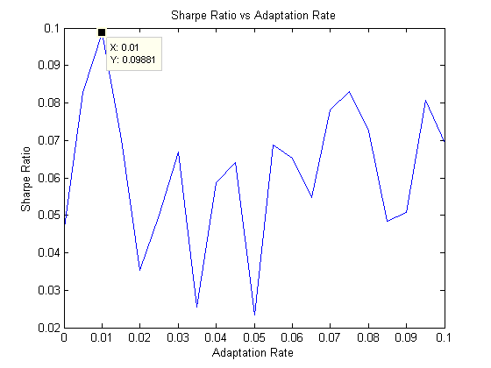
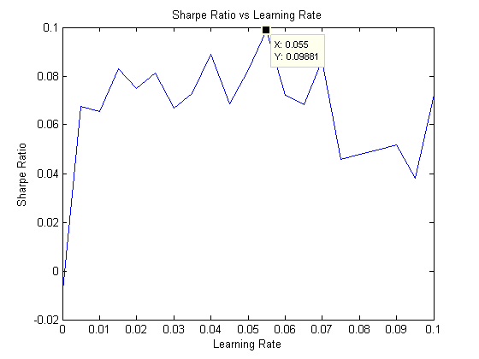


Result – Validation of Parameters
Fig 2: Validation of $η$
Fig 3: Validation of $ρ$

Slide 9
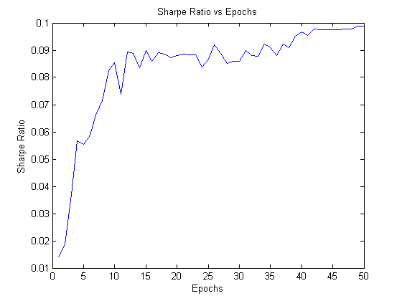
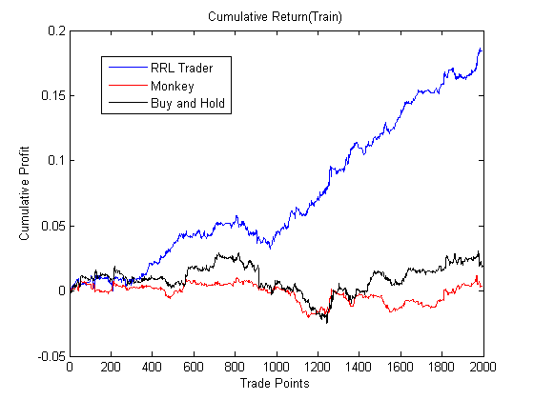
Results – Performance on Training Data
Fig 4: Sharpe Ratio
Fig 5: Cumulative Returns

Slide 10
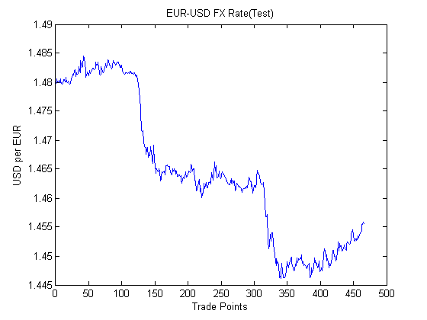
Results – Test Data
Tested on sample data between 03/02/2008 until 10/2/2008 with nearly 470 trading points.
Fig 6: Test Data

Slide 11
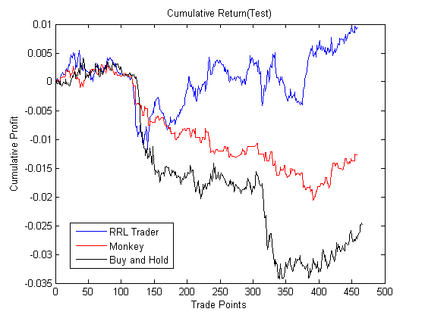
Results – Performance on Test Data
No Commissions
RRL performs better than the random strategy (monkey) and Buy – Hold strategy.
Fig 7: Cumulative Returns

Slide 12
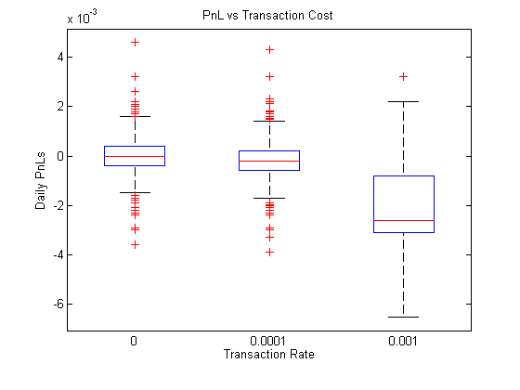
Results – Different Transaction Costs
RRL performs badly as transaction rate increases.
Boxplots for transaction rate of 0%, 0.01% & 0.1% (actual transaction cost) are shown in the figure.
Additional Layers to control the frequency of trade is required to minimize losses due to transactions.
Fig 8: Boxplots

Slide 13
Challenges Faced
Model Parameters:
If and how to normalize weights ?

Slide 14
Conclusions
RRL seems to struggle during volatile periods
When trading real data - the transaction cost is a KILLER !!
Large variance is a major cause for concern
Can’t unravel complex relationships in the data
Changes in market condition lead to waste of all the system’s learning during the training phase.

Slide 15
Future Work
Adding more risk management layers (e.g. Stop-Loss, retraining trigger, shut down the system under anomalous behavior).
Dynamic optimization of external parameters (such as learning-rate).
Working with more than one security
Working with variable number of stock size

Slide 16
References
J Moody, M Saffell, Learning to Trade via Direct Reinforcement, IEEE Transactions on Neural Networks,Vol 12, No 4, July 2001
Carl Gold, FX Trading via Recurrent Reinforcement Learning, CIFE, Hong Kong, 2003
M.A.H. Dempster, V. Leemans, An Automated FX trading system using adaptive reinforcement learning, Expert Systems with Applications 30, pp.543-552, 2006
G. Molina, Stock Trading with Recurrent Reinforcement Learning(RRL).
Lior Kupfer, Pavel Lifshits, Trading System based on RRL.

Slide 17
Questions ?
THANK YOU

